Slide 1
Two Types of Relationship Constraints
Cardinality Ratios
  One to one (1:1)
  One to Many (1:M)
  Many to Many (N:M)
Participation Constraints
  Total
  Partial
1

Slide 2
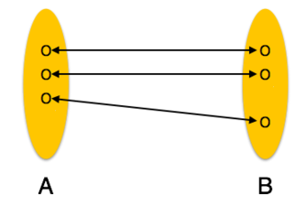
Cardinality is a constraint on a relationship specifying the number of entity instances that a specific entity may be related to via the relationship.
One to One:
One entity from entity set A can be associated with at most one entity of entity set B and vice versa.

Slide 3

Faculty
Heads
Department
1
1

Slide 4
Example
Dr. Guruprasad
Dr. Gowrishankar
CSE
ISE
Faculty
Entity
Department
Entity
Heads
relationship

Slide 5

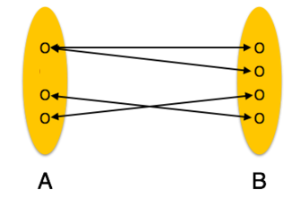
One to Many:
One entity from entity set A can be associated with more than one entities of entity set B however an entity from entity set B, can be associated with at most one entity.
Entity A
R
Entity B
1
M

Slide 6
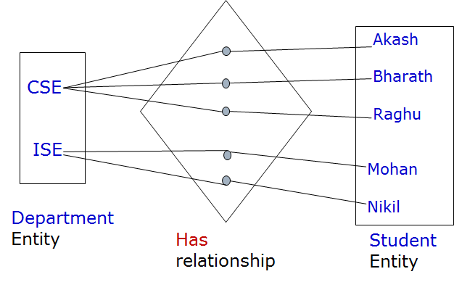
Example
Department
1
Has
M
Student

Slide 7
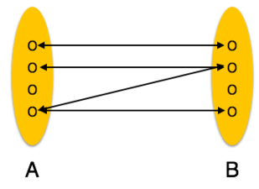
Many to Many:
One entity from A can be associated with more than one entity from B and vice versa.
Entity A
N
R
M
Entity B

Slide 8
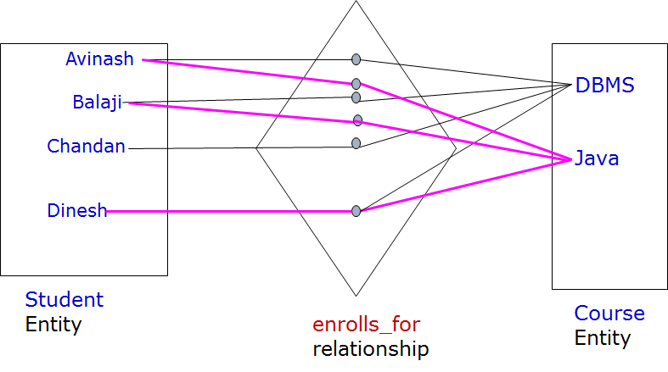
Example

Slide 9
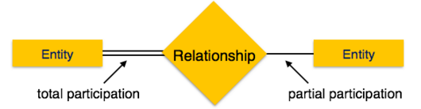
Minimum number of relationship instance that each entity can participate in.
Total Participation − Each entity is involved in the relationship. Total participation is represented by double lines.
Partial participation − Not all entities are involved in the relationship. Partial participation is represented by single lines.

Slide 10
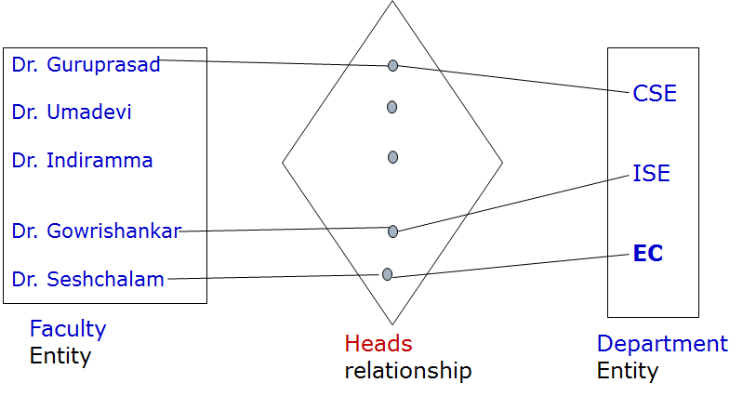

Example

Slide 11


Relationship
Total Participation of Entity A in R
Cardinality Ratio 1:N for Entity A : B in R

Slide 12

A popular car service centre wanted maintain the complete information about their customers and serviced cars. Car manufacturer makes different model cars and sell to various customers. Customer owns one or more cars with same or different companies. Customer approaches XYZ car service centre for repair. Service centre assign a mechanic for the repairs cars belongs to customer. After the service customers will be charged.

Slide 13
